Slide 1
Profiling and Parallelizing with the OpenACC Toolkit
OpenACC Course: Lecture 2 – October 15, 2015

Slide 2
Oct 1: Introduction to OpenACC
Oct 6: Office Hours
Oct 15: Profiling and Parallelizing with the OpenACC Toolkit
Oct 20: Office Hours
Oct 29: Expressing Data Locality and Optimizations with OpenACC
Nov 3: Office Hours
Nov 12: Advanced OpenACC Techniques
Nov 24: Office Hours
Course Syllabus

Slide 3
Introduction to Accelerated Computing
Identifying Available Parallelism
Expressing Parallelism with OpenACC
Next Steps and Homework
Agenda

Slide 4
Introduction to Accelerated Computing

Slide 5



Accelerated Computing 10x Performance & 5x Energy Efficiency for HPC
GPU Accelerator
Optimized for
Parallel Tasks
CPU
Optimized for
Serial Tasks

Slide 6
Accelerated Computing 10x Performance & 5x Energy Efficiency for HPC
CPU Strengths
Very large main memory
Very fast clock speeds
Latency optimized via large caches
Small number of threads can run very quickly
CPU Weaknesses
Relatively low memory bandwidth
Cache misses very costly
Low performance/watt
GPU Accelerator
Optimized for
Parallel Tasks
CPU
Optimized for
Serial Tasks

Slide 7
Accelerated Computing 10x Performance & 5x Energy Efficiency for HPC
GPU Strengths
High bandwidth main memory
Significantly more compute resources
Latency tolerant via parallelism
High throughput
High performance/watt
GPU Weaknesses
Relatively low memory capacity
Low per-thread performance
GPU Accelerator
Optimized for
Parallel Tasks
CPU
Optimized for
Serial Tasks

Slide 8

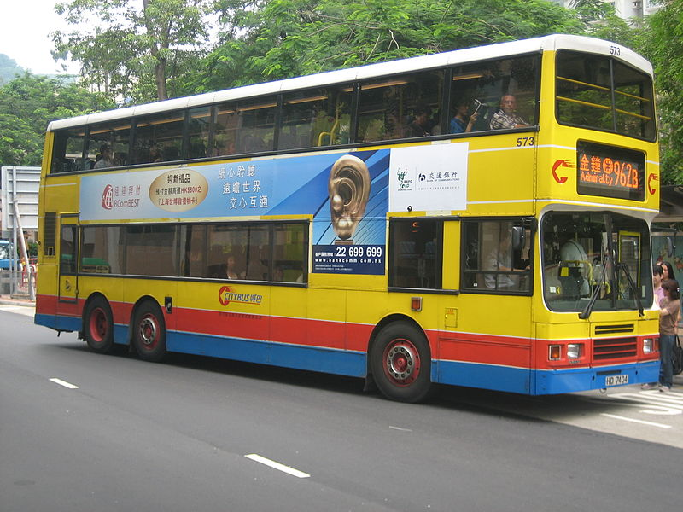
Speed v. Throughput
Speed
Throughput
Which is better depends on your needs…
*Images from Wikimedia Commons via Creative Commons

Slide 9
Accelerator Nodes
CPU and GPU have distinct memories
CPU generally larger and slower
GPU generally smaller and faster
CPU and GPU communicate via PCIe
Data must be copied between these memories over PCIe
PCIe Bandwidth is much lower than either memories
RAM
RAM
PCIe

Slide 10
CUDA Unified Memory
Sometimes referred to as “managed memory.”
Simplified Developer Effort
Without Unified Memory
With Unified Memory
System Memory
GPU Memory
Unified Memory

Slide 11
Identify Available Parallelism
Express Parallelism
Express Data Movement
Optimize Loop Performance

Slide 12
Identify Available Parallelism
Express Parallelism
Express Data Movement
Optimize Loop Performance

Slide 13
Case Study
For lectures and labs 2 & 3 we will use an example code that solves a conjugate gradient problem.
This code is available in C and Fortran, but only C will be shown in the lectures.
We will be demonstrating OpenACC concepts using this code in the next 2 lectures.
You will be profiling and accelerating this code in the next 2 labs.
In addition to the labs, the code is available at https://github.com/NVIDIA-OpenACC-Course/nvidia-openacc-course-sources/tree/master/labs

Slide 14
Identifying Available Parallelism

Slide 15
NVIDIA NVPROF Profiler
NVPROF is a command-line profiler provided in the OpenACC and CUDA Toolkits
Basic CPU Profiling (New in OpenACC Toolkit & CUDA 7.5)
GPU Profiling
High-level usage statistics
Timeline Collection
Analysis Metrics
Used behind-the-scenes by NVIDIA Visual Profiler (nvvp)

Slide 16
NVPROF CPU Profiling
$ nvprof --cpu-profiling on --cpu-profiling-mode top-down ./cg
Rows: 8120601, nnz: 218535025
Iteration: 0, Tolerance: 4.0067e+08
Iteration: 10, Tolerance: 1.8772e+07
Iteration: 20, Tolerance: 6.4359e+05
Iteration: 30, Tolerance: 2.3202e+04
Iteration: 40, Tolerance: 8.3565e+02
Iteration: 50, Tolerance: 3.0039e+01
Iteration: 60, Tolerance: 1.0764e+00
Iteration: 70, Tolerance: 3.8360e-02
Iteration: 80, Tolerance: 1.3515e-03
Iteration: 90, Tolerance: 4.6209e-05
Total Iterations: 100 Total Time: 33.926116s
======== CPU profiling result (top down):
99.89% main
| 83.22% matvec(matrix const &, vector const &, vector const &)
| 10.41% waxpby(double, vector const &, double, vector const &, vector const &)
| 3.81% dot(vector const &, vector const &)
| 2.42% allocate_3d_poission_matrix(matrix&, int)
| 0.03% free_matrix(matrix&)
| 0.03% munmap
0.11% __c_mset8
======== Data collected at 100Hz frequency

Slide 17
GPROF Profiler
Portable command-line profiler available from GCC.
When used with PGI or GCC, the following steps are required:
Add the –pg compiler flag to instrument your code
Run the executable (it will produce gmon.out)
Run gprof ./executable to analyze the collected data

Slide 18
GPROF Output for Case Study
Add –pg to compiler flags, rebuild & rerun, use gprof
Each sample counts as 0.01 seconds.
% cumulative self self total
time seconds seconds calls ms/call ms/call name
77.32 24.82 24.82 101 245.74 245.74 matvec(matrix const&, vector const&, vector const&)
15.36 29.75 4.93 302 16.32 16.32 waxpby(double, vector const&, double, vector const&, vector const&)
4.24 31.11 1.36 200 6.80 6.80 dot(vector const&, vector const&)
3.08 32.10 0.99 1 990.00 990.00 allocate_3d_poission_matrix(matrix&, int)
0.00 32.10 0.00 5 0.00 0.00 allocate_vector(vector&, unsigned int)
0.00 32.10 0.00 4 0.00 0.00 free_vector(vector&)
0.00 32.10 0.00 2 0.00 0.00 initialize_vector(vector&, double)
0.00 32.10 0.00 1 0.00 0.00 free_matrix(matrix&)

Slide 19
PGI Compiler Feedback
Understanding what the compiler does with your code is critical to understanding the profile.
PGI –Minfo flag, options we’ll use:
accel – Print compiler operations related to the accelerator
all – Print (nearly) all compiler output
intensity – Print loop intensity information
ccff – Add information to the object files for use by tools

Slide 20
Compiler Feedback for Case Study
Add –Minfo=all,intensity to compiler flags and rebuild
$ pgc++ -fast -Minfo=all,intensity main.cpp -o cg
waxpby(double, const vector &, double, const vector &, const vector &):
5, include "vector_functions.h"
24, Intensity = 1.00
Generated 4 alternate versions of the loop
Generated vector and scalar versions of the loop; pointer conflict tests determine which is executed
Generated 2 prefetch instructions for the loop
Loop unrolled 4 times
matvec(const matrix &, const vector &, const vector &):
7, include "matrix_functions.h"
14, Intensity = (num_rows*((row_end-row_start)* 2))/(num_rows+(num_rows+(num_rows+((row_end-row_start)+(row_end-row_start)))))
18, Intensity = 1.00
Unrolled inner loop 4 times
Generated 2 prefetch instructions for the loop

Slide 21
Computational Intensity
Computational Intensity of a loop is a measure of how much work is being done compared to memory operations.
Computation Intensity = Compute Operations / Memory Operations
Computational Intensity of 1.0 or greater is often a clue that something might run well on a GPU.

Slide 22
Analyzing the Code: Matvec
for(int i=0;i<num_rows;i++) {
double sum=0;
int row_start=row_offsets[i];
int row_end=row_offsets[i+1];
for(int j=row_start;
j<row_end;j++) {
unsigned int Acol=cols[j];
double Acoef=Acoefs[j];
double xcoef=xcoefs[Acol];
sum+=Acoef*xcoef;
}
ycoefs[i]=sum;
}
Look for data dependencies:
Does one loop iteration affect other loop iterations?
Do loop iterations read from and write to different places in the same array?
Is sum a data dependency? No, it’s a reduction.

Slide 23
Analyzing the Code: Waxpy and Dot
for(int i=0;i<n;i++) {
wcoefs[i] =
alpha*xcoefs[i] +
beta*ycoefs[i];
}
for(int i=0;i<n;i++) {
sum+=xcoefs[i]*ycoefs[i];
}
Look for data dependencies:
Does one loop iteration affect other loop iterations?
Do loop iterations read from and write to different places in the same array?

Slide 24
Expressing Parallelism

Slide 25
OpenACC kernels Directive
Identifies a region of code where I think the compiler can turn loops into kernels
#pragma acc kernels
{
for(int i=0; i<N; i++)
{
x[i] = 1.0;
y[i] = 2.0;
}
for(int i=0; i<N; i++)
{
y[i] = a*x[i] + y[i];
}
}
The compiler identifies 2 parallel loops and generates 2 kernels.
kernel 1
kernel 2
Notes:
Note: The term “kernel” should be explained briefly, but will be explained in more depth in the second lecture.

Slide 26
OpenACC kernels Directive (Fortran)
Identifies a region of code where I think the compiler can turn loops into kernels
!$acc kernels
do i=1,N
x(i) = 1.0
y(i) = 2.0
end do
y(:) = a*x(:) + y(:)
!$acc end kernels
The compiler identifies 2 parallel loops and generates 2 kernels.
kernel 1
kernel 2
Notes:
Note: The term “kernel” should be explained briefly, but will be explained in more depth in the second lecture.

Slide 27
Loops vs. Kernels
for (int i = 0; i < 16384; i++)
{
C[i] = A[i] + B[i];
}
function loopBody(A, B, C, i)
{
C[i] = A[i] + B[i];
}

Slide 28
Loops vs. Kernels
for (int i = 0; i < 16384; i++)
{
C[i] = A[i] + B[i];
}
function loopBody(A, B, C, i)
{
C[i] = A[i] + B[i];
}
Calculate 0 -16383 in order.

Slide 29
Loops vs. Kernels
for (int i = 0; i < 16384; i++)
{
C[i] = A[i] + B[i];
}
function loopBody(A, B, C, i)
{
C[i] = A[i] + B[i];
}
Calculate 0
Calculate 0 -16383 in order.

Slide 30
Loops vs. Kernels
for (int i = 0; i < 16384; i++)
{
C[i] = A[i] + B[i];
}
function loopBody(A, B, C, i)
{
C[i] = A[i] + B[i];
}
Calculate 0
Calculate 0 -16383 in order.
Calculate 1
Calculate 2
Calculate 3
Calculate 0
Calculate 4
Calculate 1
Calculate 2
Calculate 3
Calculate 9
Calculate 0
Calculate 1
Calculate 2
Calculate 3
Calculate 14
Calculate 0
Calculate 1
Calculate 2
Calculate 3
Calculate …
Calculate 0
Calculate 1
Calculate 2
Calculate 3
Calculate 16383

Slide 31
The Kernels Directive
Identifies a region of code where I think the compiler can turn loops into kernels
#pragma acc kernels
{
for (int i = 0; i < 16384;
i++)
{
C[i] = A[i] + B[i];
}
}
The Compiler will…
Analyze the code to determine if it contains parallelism
Identify data that needs to be moved to/from the GPU memory
Generate kernels
Run on the GPU

Slide 32
Parallelizing the Code: Matvec
#pragma acc kernels
{
for(int i=0;i<num_rows;i++) {
double sum=0;
int row_start=row_offsets[i];
int row_end=row_offsets[i+1];
for(int j=row_start;
j<row_end;j++) {
unsigned int Acol=cols[j];
double Acoef=Acoefs[j];
double xcoef=xcoefs[Acol];
sum+=Acoef*xcoef;
}
ycoefs[i]=sum;
}
}
Let’s tell the compiler where we think it can turn loops into kernels.
Don’t worry about your data or how to parallelize these loops, let the compiler decide.

Slide 33
Building with OpenACC
Enable OpenACC with the –ta (target accelerator) flag.
Target Accelerator:
tesla – NVIDIA Tesla GPU
managed – Use CUDA Managed Memory (simplifies the process)

Slide 34
Building with OpenACC - Feedback
$ pgc++ -fast -Minfo=accel -ta=tesla:managed main.cpp -o challenge
matvec(const matrix &, const vector &, const vector &):
7, include "matrix_functions.h"
15, Generating copyout(ycoefs[:num_rows])
Generating copyin(xcoefs[:],Acoefs[:],cols[:],row_offsets[:num_rows+1])
16, Complex loop carried dependence of row_offsets-> prevents parallelization
Loop carried dependence of ycoefs-> prevents parallelization
Loop carried backward dependence of ycoefs-> prevents vectorization
Complex loop carried dependence of cols->,Acoefs->,xcoefs-> prevents parallelization
Accelerator kernel generated
Generating Tesla code
20, #pragma acc loop vector(128) /* threadIdx.x */
24, Sum reduction generated for sum
20, Loop is parallelizable

Slide 35
False Loop Dependencies
Aliasing prevents parallelization.
The compiler things there’s a carried dependency in our loop iterations, but we thought they were parallel. Only the innermost loop was parallelized.
In C/C++, the arrays are simply pointers, so they may be aliased (two pointers accessing the same memory differently). If the compiler doesn’t know pointers aren’t aliased, it must assume they are.
This is not a problem with Fortran arrays.

Slide 36

C99: restrict Keyword
Promise given by the programmer to the compiler that pointer will not alias with another pointer
Applied to a pointer, e.g.
float *restrict ptr
Meaning: “for the lifetime of ptr, only it or a value directly derived from it (such as ptr + 1) will be used to access the object to which it points”*
Parallelizing compilers often require restrict to determine independence
Otherwise the compiler can’t parallelize loops that access ptr
Note: if programmer violates the declaration, behavior is undefined
float restrict *ptr
float *restrict ptr
http://en.wikipedia.org/wiki/Restrict

Slide 37
Loop independent clause
Specifies that loop iterations are data independent. This overrides any compiler dependency analysis. This is implied for parallel loop.
#pragma acc kernels
{
#pragma acc loop independent
for(int i=0; i<N; i++)
{
a[i] = 0.0;
b[i] = 1.0;
c[i] = 2.0;
}
#pragma acc loop independent
for(int i=0; i<N; i++)
{
a[i] = b[i] + c[i]
}
}
Informs the compiler that both loops are safe to parallelize so it will generate both kernels.
kernel 1
kernel 2

Slide 38
Fixing False Aliasing
unsigned int num_rows=A.num_rows;
unsigned int *restrict \
row_offsets=A.row_offsets;
unsigned int *restrict \
cols=A.cols;
double *restrict Acoefs=A.coefs;
double *restrict xcoefs=x.coefs;
double *restrict ycoefs=y.coefs;
By declaring our pointers with the restrict keyword, we’ve promised the compiler they will not alias.
We could also use loop independent on our loops, but restrict fixes the underlying issue.

Slide 39
Rebuilding with OpenACC - Feedback
$ pgc++ -fast -Minfo=accel -ta=tesla:managed main.cpp -o challenge
matvec(const matrix &, const vector &, const vector &):
7, include "matrix_functions.h"
15, Generating copyout(ycoefs[:num_rows])
Generating copyin(xcoefs[:],Acoefs[:],cols[:],row_offsets[:num_rows+1])
16, Loop is parallelizable
Accelerator kernel generated
Generating Tesla code
16, #pragma acc loop gang, vector(128) /* blockIdx.x threadIdx.x */
20, Loop is parallelizable

Slide 40
Performance Now
Remember, a slow-down is expected at this point due to excess data movement.
Time (seconds)
Put specs here…

Slide 41
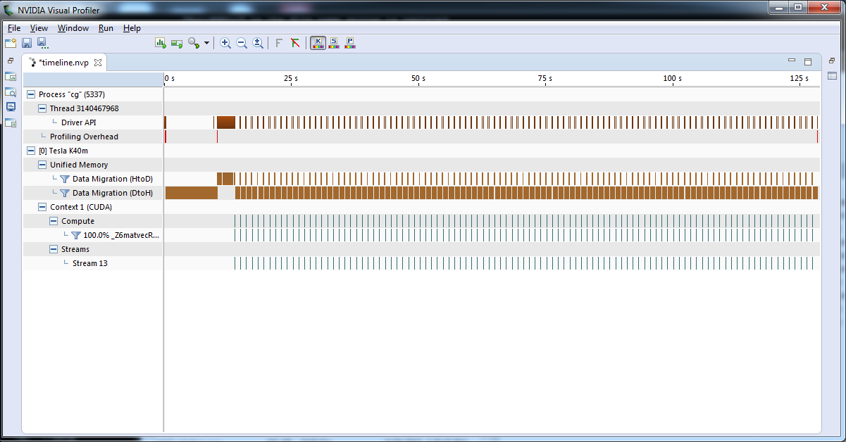
Re-profiling the code
Application Runtime
Total Time | 135 s
GPU Kernels (matvec) | 8 s
Data Migration (Unified Memory) | 71 s

Slide 42
Performance After Lab 2
Once you’ve moved all 3 functions to the GPU, data movement will go away.
Time (seconds)
Intel(R) Xeon(R) CPU E5-2698 v3 @ 2.30GHz and NVIDIA Tesla K40 GPU

Slide 43
OpenACC parallel loop Directive
parallel - Programmer identifies a block of code containing parallelism. Compiler generates a kernel.
loop - Programmer identifies a loop that can be parallelized within the kernel.
NOTE: parallel & loop are often placed together
#pragma acc parallel loop
for(int i=0; i<N; i++)
{
y[i] = a*x[i]+y[i];
}
NOTE: The independent clause to loop is implied when used within a parallel region.
Generates a Parallel Kernel

Slide 44
OpenACC loop directive: private & reduction
The private and reduction clauses are not optimization clauses, they may be required for correctness.
private – A copy of the variable is made for each loop iteration
reduction - A reduction is performed on the listed variables.
Supports +, *, max, min, and various logical operations
Note: The kernels directive will generally handle these for you.

Slide 45
Using Parallel Loop
#pragma acc parallel loop
for(int i=0;i<num_rows;i++) {
double sum=0;
int row_start=row_offsets[i];
int row_end=row_offsets[i+1];
#pragma acc loop reduction(+:sum)
for(int j=row_start;
j<row_end;j++) {
unsigned int Acol=cols[j];
double Acoef=Acoefs[j];
double xcoef=xcoefs[Acol];
sum+=Acoef*xcoef;
}
ycoefs[i]=sum;
}
Instead of letting the compiler analyze the loops, let’s tell the compiler they’re parallel.
Adding a loop directive to inner loops will tell the compiler they’re also independent.
We must specify the reduction on sum for correctness.

Slide 46
Rebuilding with Parallel Loop - Feedback
$ pgc++ -fast -Minfo=accel -ta=tesla:managed main.cpp -o challenge
matvec(const matrix &, const vector &, const vector &):
8, include "matrix_functions.h"
12, Accelerator kernel generated
Generating Tesla code
15, #pragma acc loop gang /* blockIdx.x */
20, #pragma acc loop vector(128) /* threadIdx.x */
Sum reduction generated for sum
12, Generating copyout(ycoefs[:num_rows])
Generating copyin(xcoefs[:],Acoefs[:],cols[:],row_offsets[:num_rows+1])
20, Loop is parallelizable

Slide 47
OpenACC parallel loop vs. kernels
PARALLEL LOOP
Programmer’s responsibility to ensure safe parallelism
Will parallelize what a compiler may miss
Straightforward path from OpenMP
KERNELS
Compiler’s responsibility to analyze the code an parallelize what is safe.
Can cover larger area of code with single directive
Gives compiler additional leeway to optimize.
Both approaches are equally valid and can perform equally well.

Slide 48
Review
Today we discussed:
Tools that can be used to profile a code and identify important routines and loops where there is available parallelism
How to analyze the code for parallelism blockers
How to use the kernels and parallel loop directives to express the available parallelism to the compiler
How to build with PGI and OpenACC
How to re-profile the accelerated code

Slide 49
Next Steps & Homework

Slide 50
Identify Available Parallelism
Express Parallelism
Express Data Movement
Optimize Loop Performance
The remaining steps will be covered on October 29.

Slide 51
Homework
Go to http://bit.ly/nvoacclab2
Build and profile the example code using the PGI compiler and gprof.
Complete the acceleration of the example code by accelerating the matvec, waxpy, and dot functions using either kernels or parallel loop.
Periodically use nvprof and/or Visual Profiler to obtain accelerated profiles and observed the results of your changes.
Note: The GPUs provided via Qwiklabs will provide a much smaller speed-up than shown here (10-15%). This is expected. Lab 3 will improve upon this.

Slide 52
Office Hours Next Week
Next week’s session will be an office hours session.
Bring your questions from this week’s lecture and homework to next week’s session.
If you can’t wait until then, post a question on StackOverflow tagged with openacc.

Slide 53
Oct 1: Introduction to OpenACC
Oct 6: Office Hours
Oct 15: Profiling and Parallelizing with the OpenACC Toolkit
Oct 20: Office Hours
Oct 29: Expressing Data Locality and Optimizations with OpenACC
Nov 3: Office Hours
Nov 12: Advanced OpenACC Techniques
Nov 24: Office Hours
Course Syllabus

